Slide 1
Andres Felipe Castro
CIT 225
John Mayer Discography Database

Slide 2
Business Purpose
This database was created for all John Mayers fans with interest in information related to John Mayer's discography, awards, collaborations with other artists, and any other information related to John’s discography.

Slide 3
Deliverables
For a better understanding of the CRUD statements on these slides we suggest to refer to the following deliverable:
1)CRUD field - contains all the queries presented on this presentation
2)John Mayer model – Contains the Entity-Relationship Design (ERD) model
3)Views folder – Contains all the views in JPG format
4)John Mayer schema - Contains the statements to generate the database
5)John Mayer database – it is a sample of the database with sample data already populated

Slide 4
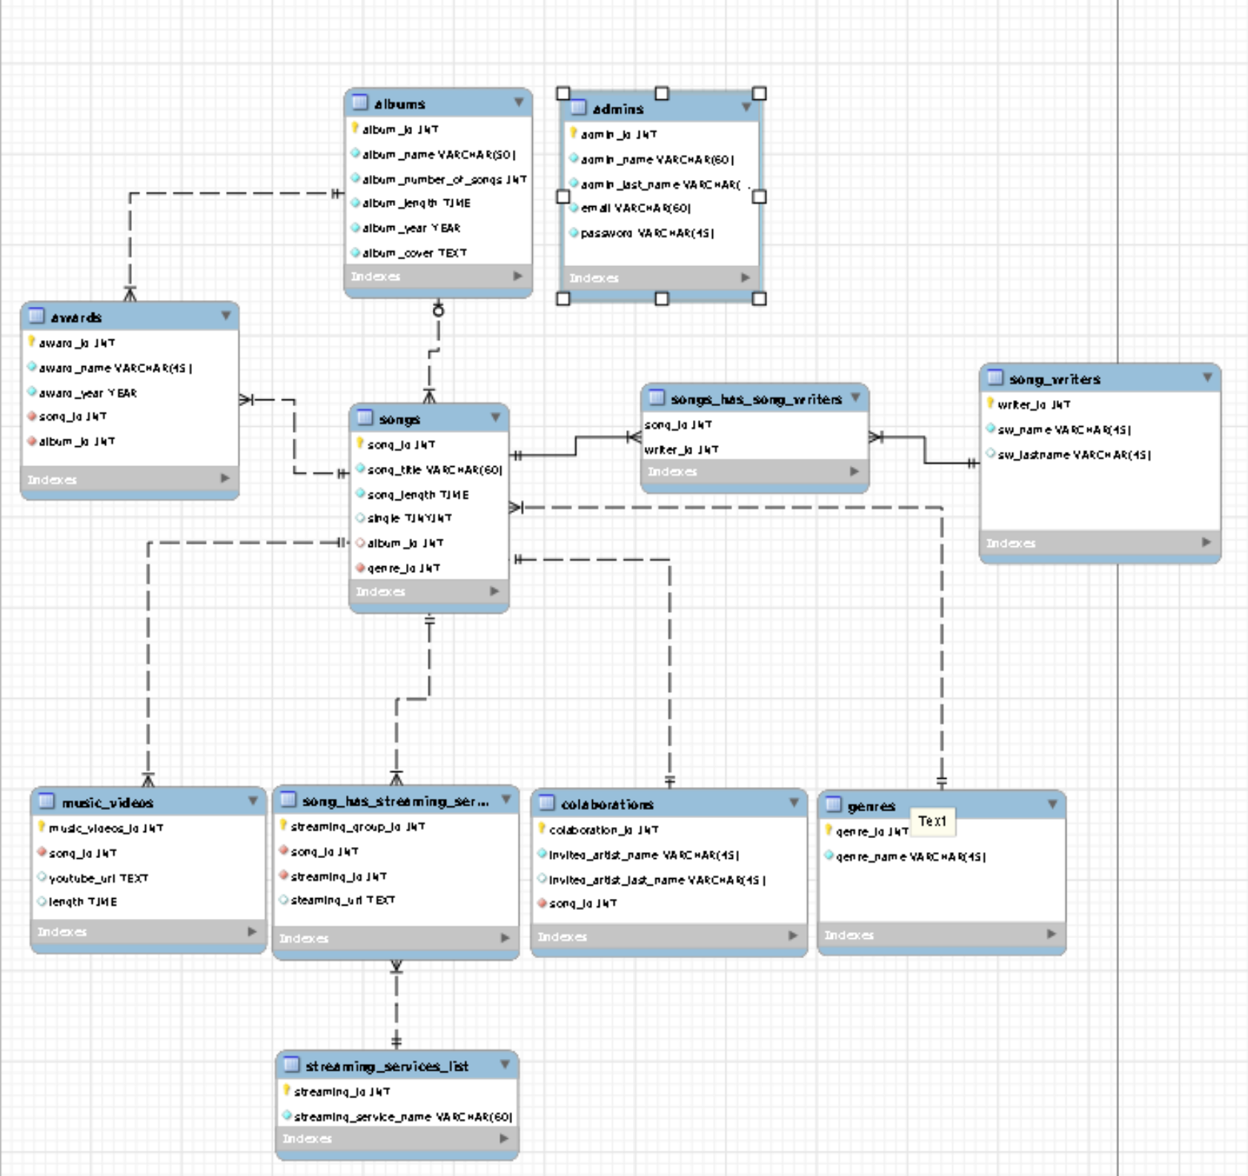
Requirements
The whole structure of the database is composed of 12 tables being the table song the core of the database

Slide 5
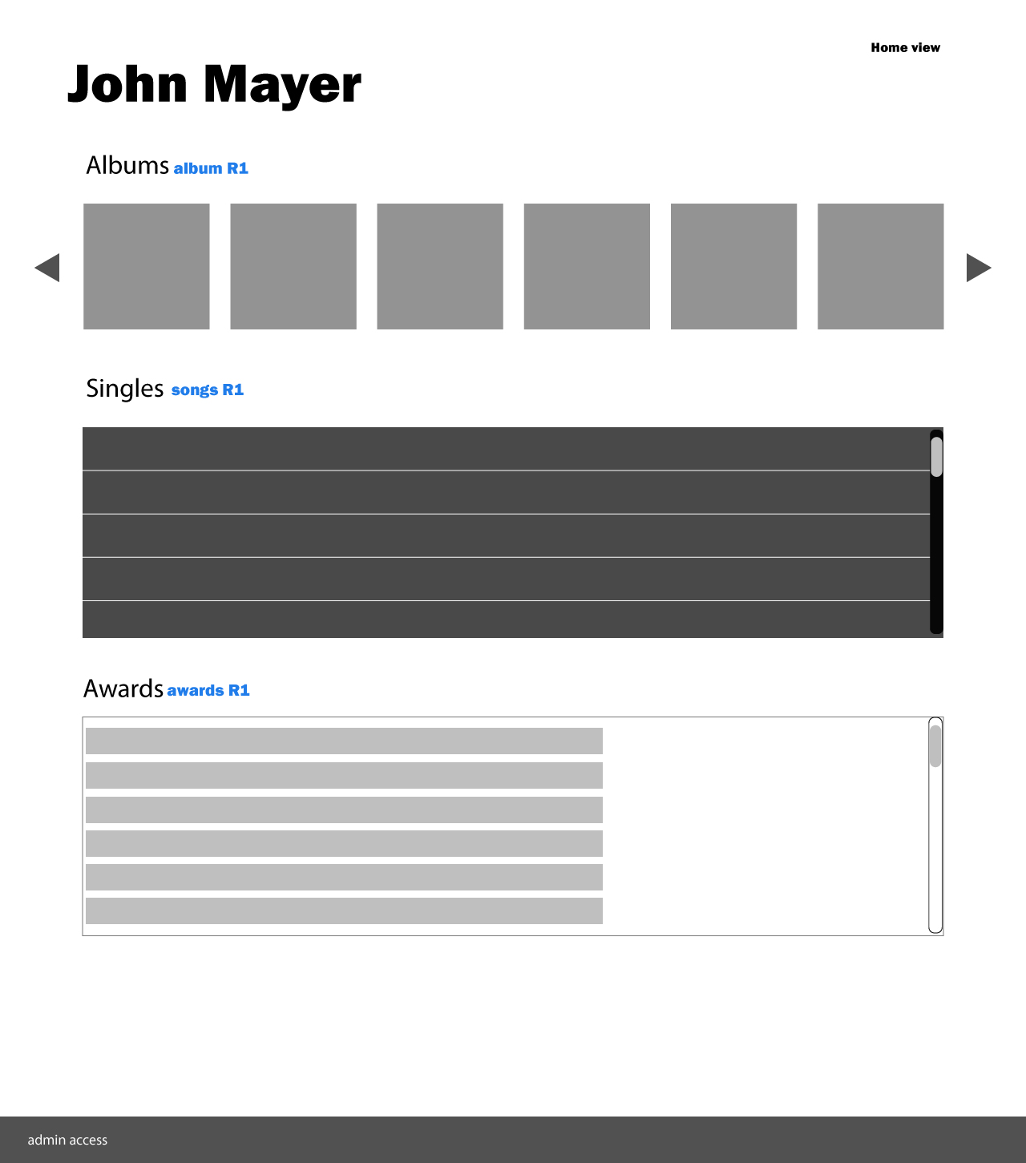
Home

Slide 6
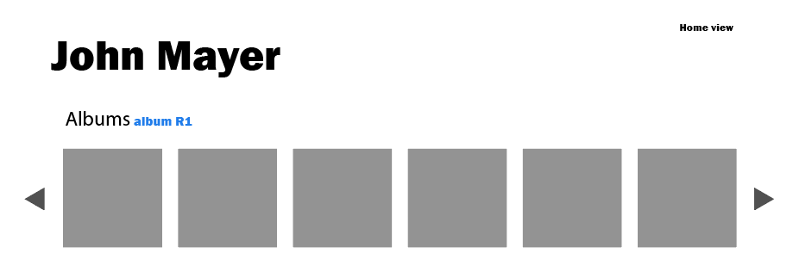
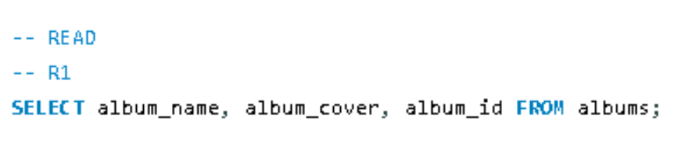
The first section of the home view will display all the albums listed on the table albums with their cover image name and ID.

Slide 7
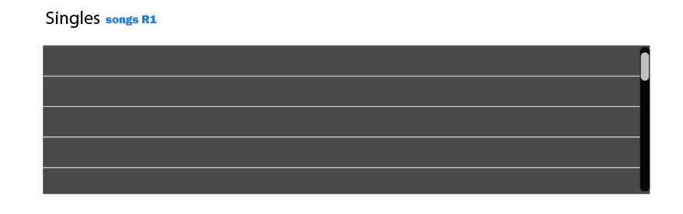
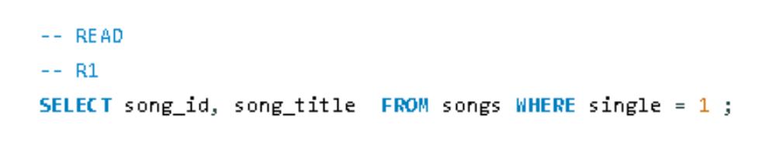
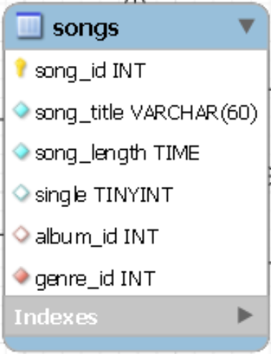
The second section will read all the songs that do not belong to an specific album or also called singles.
The table song count with a Colum called “single” where the user will be able to define id a song is a single or not. The value “1” means that single is true, while value “0” means false.

Slide 8
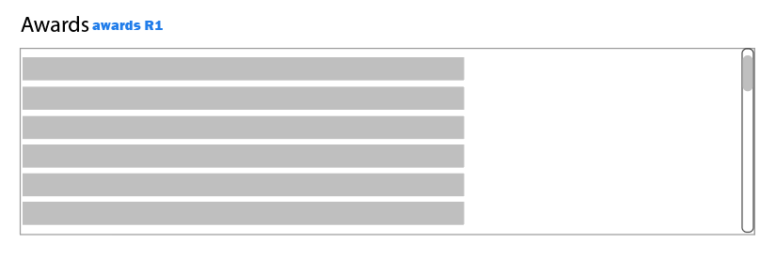
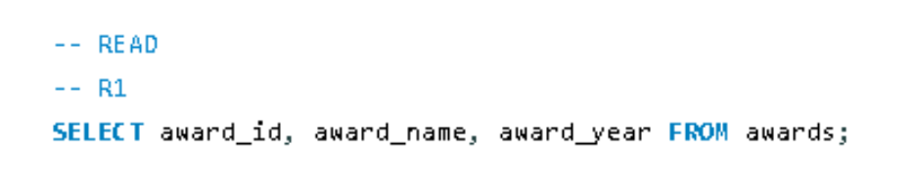
The third section will display all the awards listed in the table awards

Slide 9
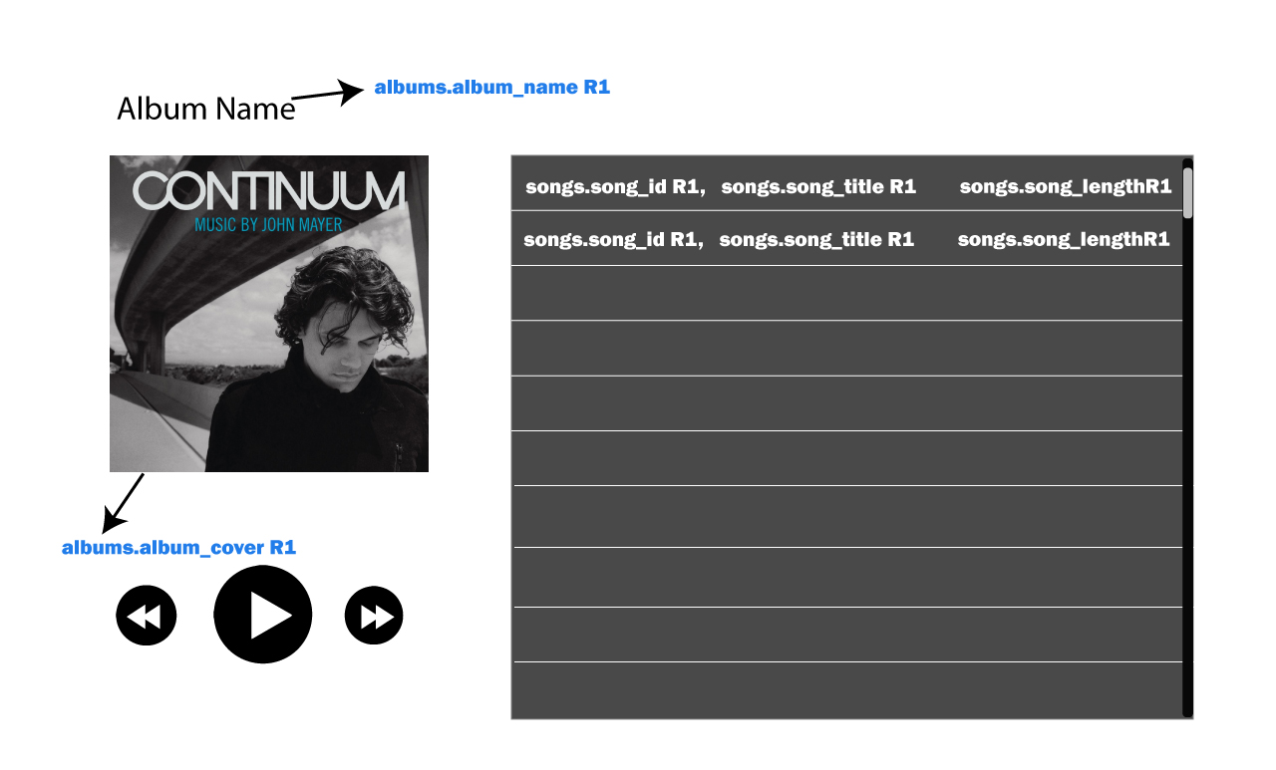
Songs View

Slide 10
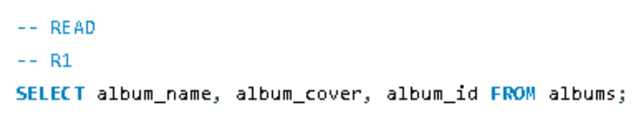
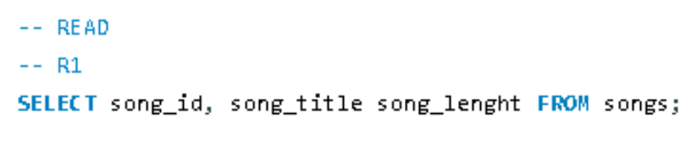
albums R1
songs R1

Slide 11
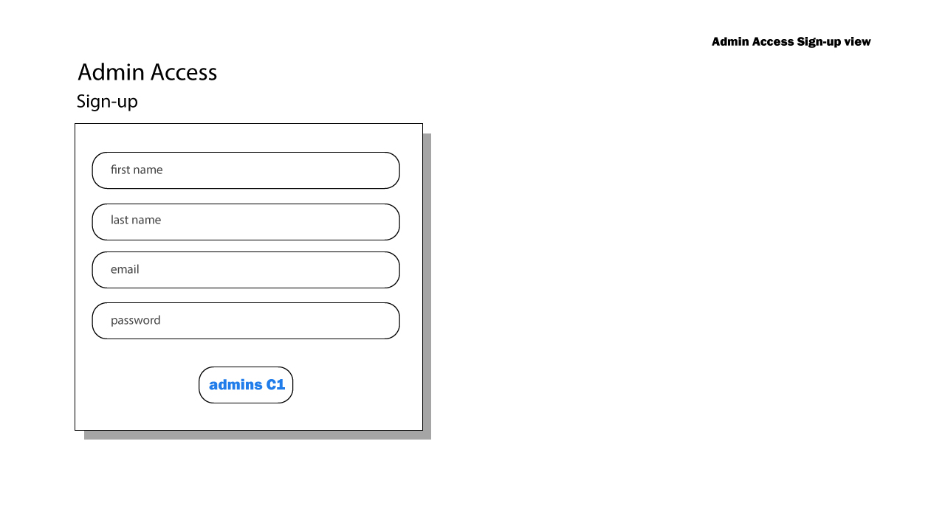
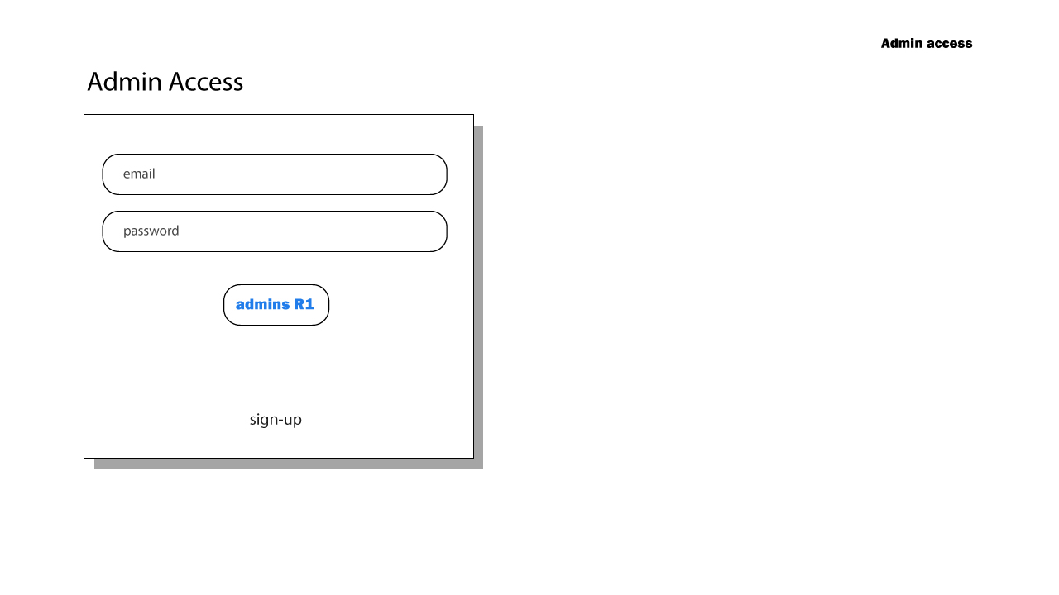
Admin log-in/sign-up

Slide 12
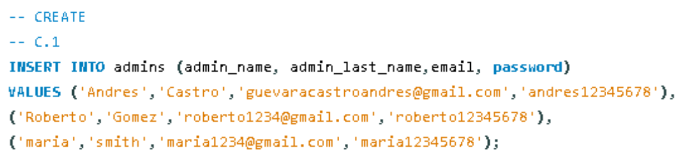
This program will be free access and users won’t need to create an account to consult the information; however, there will be a system administrator with user and account to create, edit or delete information on the website.
In the sign-up section the use will enter their personal information to create an admin account

Slide 13
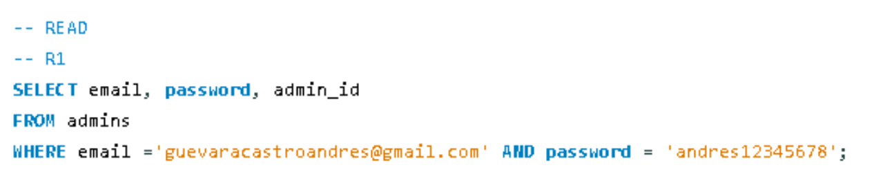
In This view, the user will enter their credentials and the database will compare the information entered by the client with the user and password stored in the database to allow access to the administrator system

Slide 14
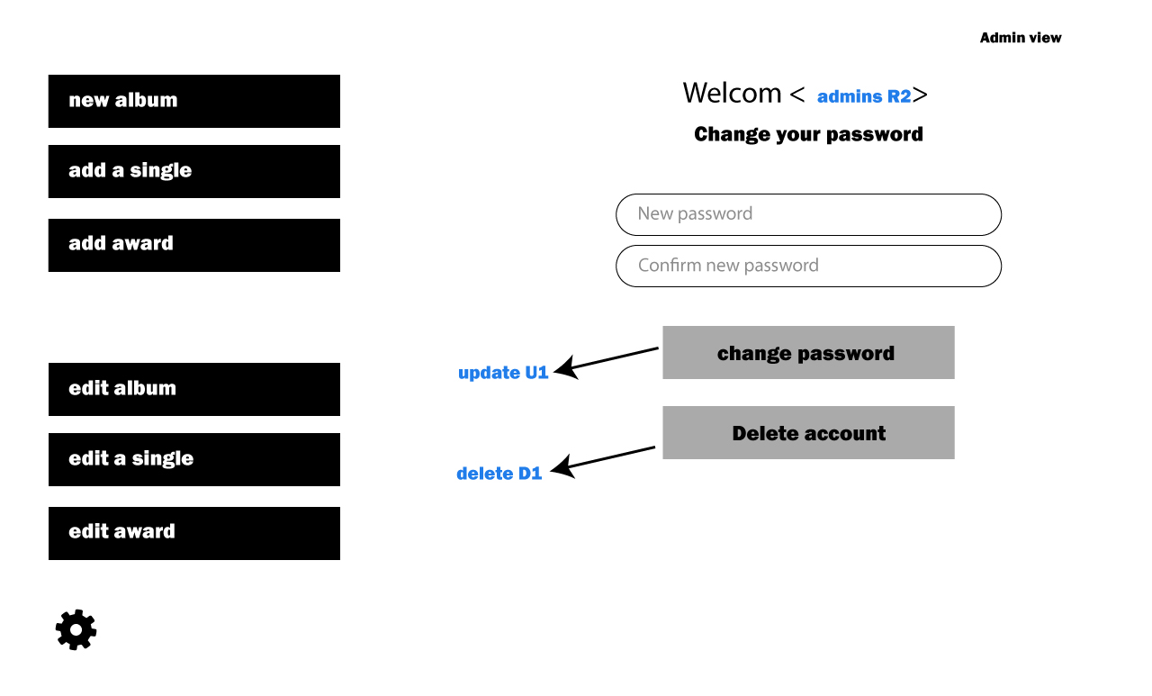
Admin View

Slide 15
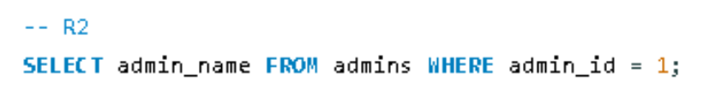
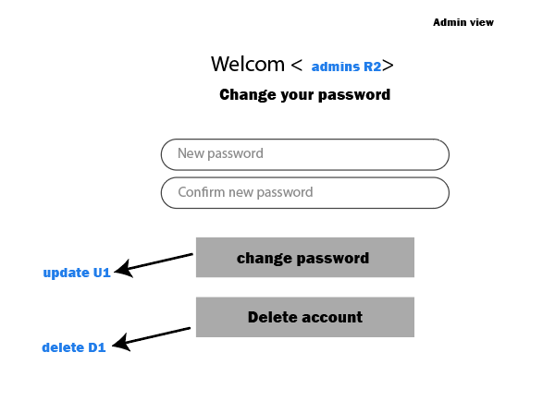
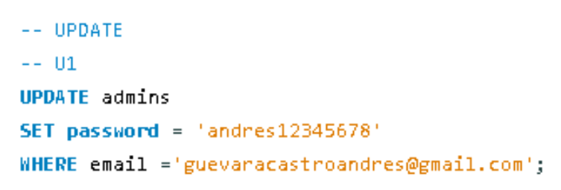
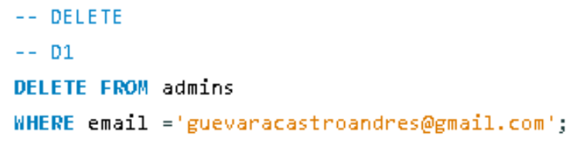
admins R2
Will read user information and display user name
update U1
Users will be able to edit and change thier password
delete D1
Users can delete the account based on the ID of the account logged-in at that moment.

Slide 16
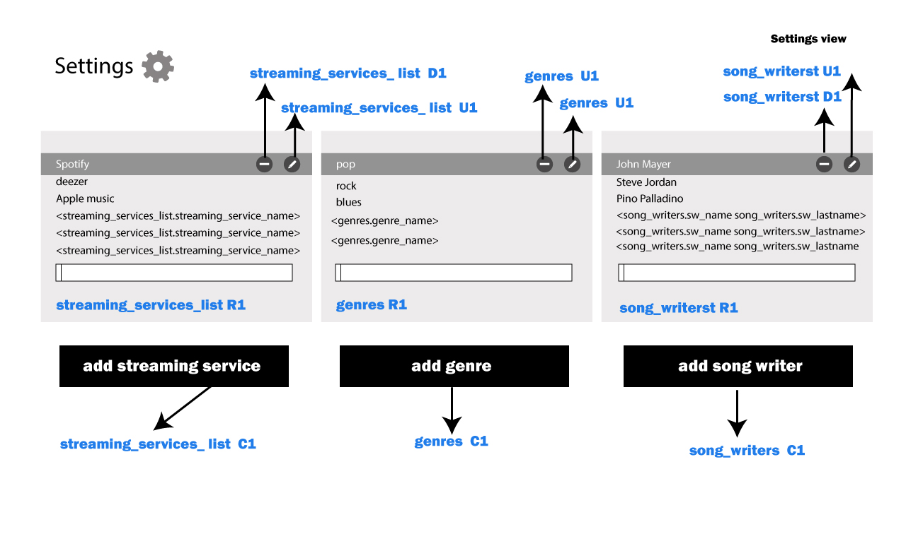
Settings View

Slide 17
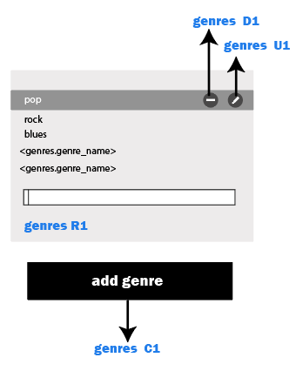
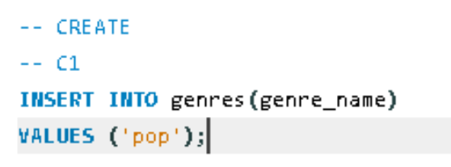
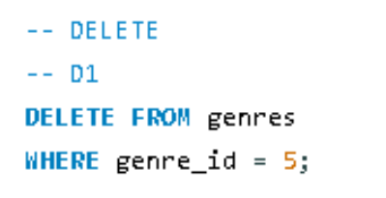
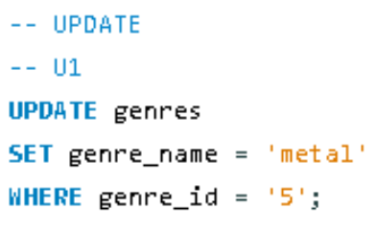
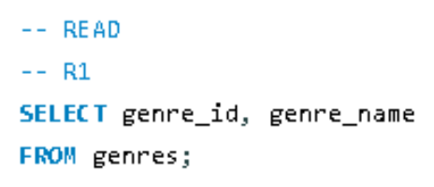
Before to create a song, The database will need some information related to streaming services, music genres, and song writers.
User will be able to add, edit and delete this information in this using this view. Next, we will see an example for the genres table
genres D1
Delete a genre of the list
genres C1
Add a new genre to the pool list
genres R1
Display all the genres in the list by name and Id
genres U1
Update a genre of the list
The same CRUD process is repeated for “streaming service”s and “writers” tables

Slide 18
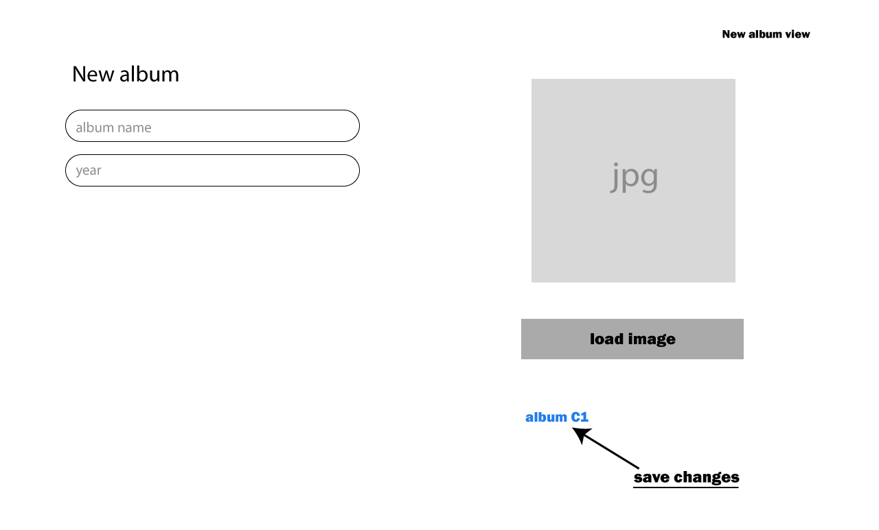
New álbum View

Slide 19
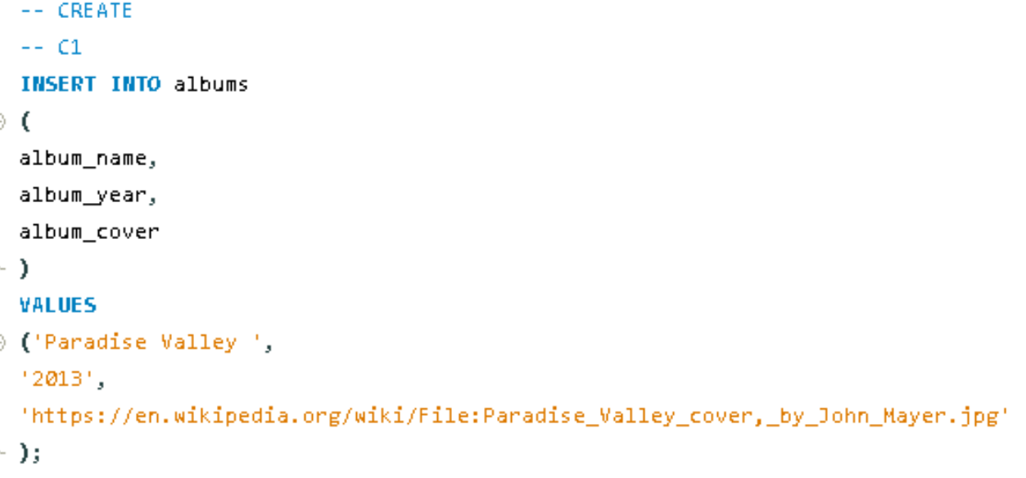
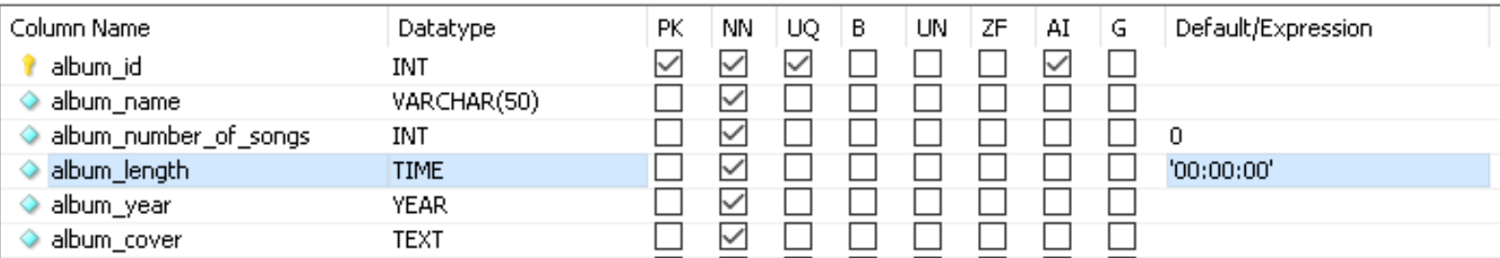
The user will enter the information required to create the album like album name and year.
Note that for the columns “album_length” and “album_number_of_songs” there is a default value of 0. This values will be modified as the user add songs to the album (explained in next slide)

Slide 20
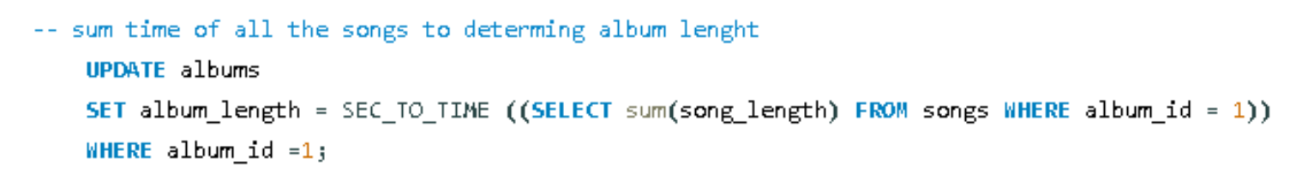
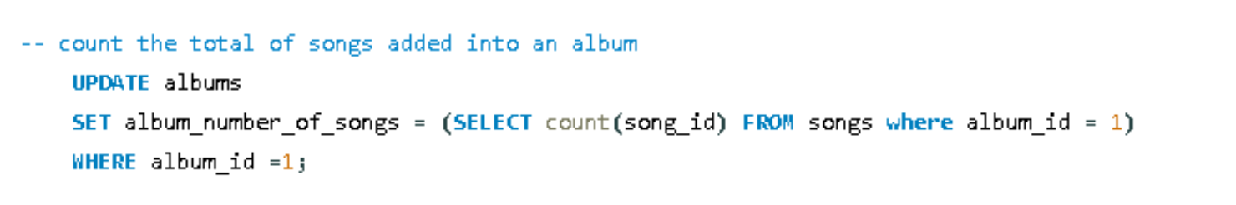
The “album_length” and “album_number_of_songs” will be calculated every time that the user adds a new song to the database. These statements will be at the end of the transaction to add songs
“album_length”
In this example the system will sum the length of the songs that belongs to the album Id “2” and updating the column album_length
“album_length”
In this example the system will count the number of songs that belongs to the album ID number 2

Slide 21
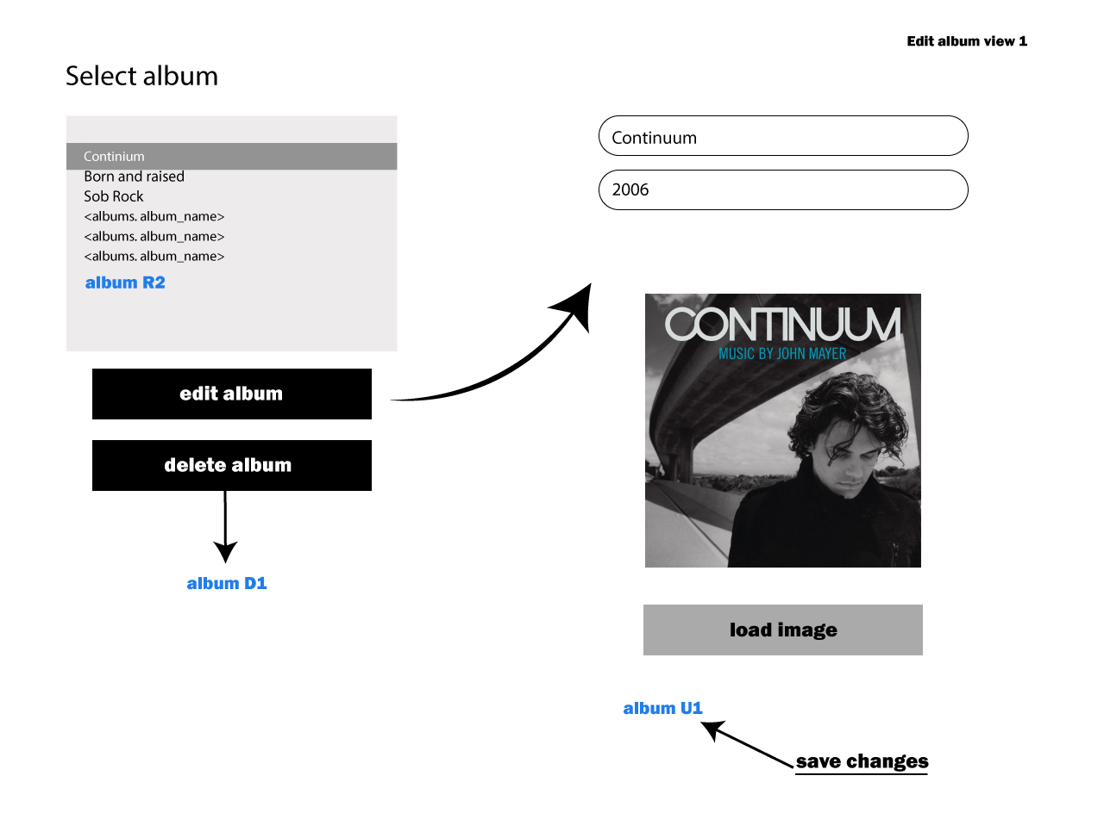
Edit álbum View

Slide 22
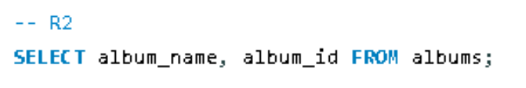
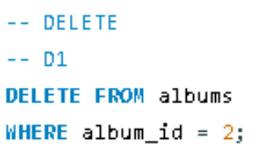
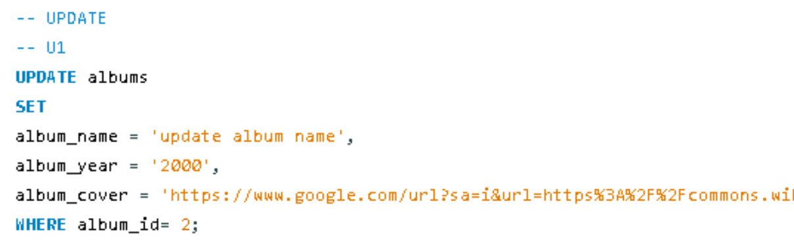
album R2
system will read and display all the albums stored in the albums table
User Will select one of the albums of the list and proceed to take any of the actions below
album D1
Delete the álbum selected
album U1
Update title, year, or album cover image

Slide 23
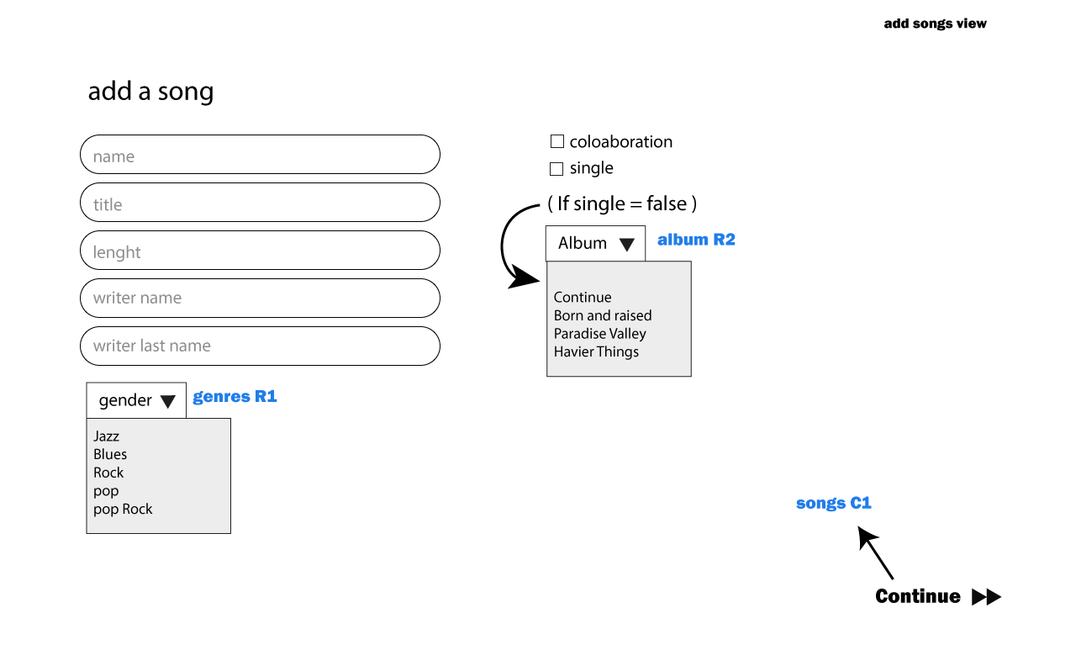
Add song View

Slide 24
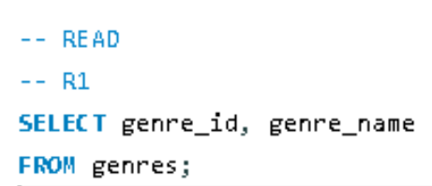
The System will read the information from two tables “genres” and “albums” to display the information required to créate the song.
genres R1
album R2

Slide 25
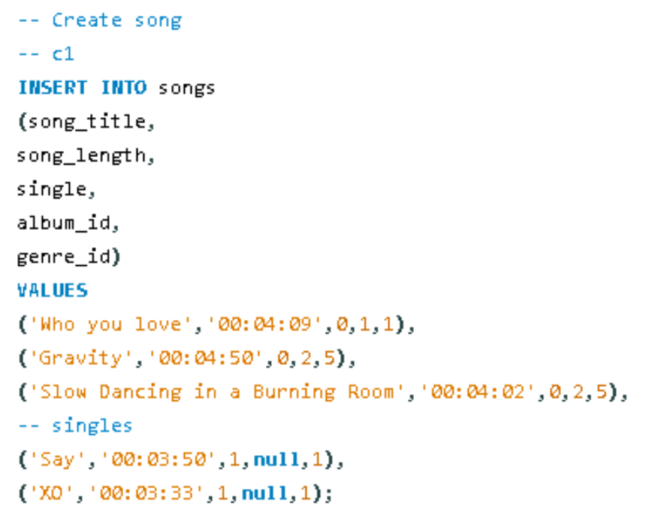
Transaction step 1
Due to the table song is connected with several important tables that also need to be edited every time that the user adds a song, this process will be within a transaction that prevents the commit of the information until all the tables have been successfully edited.
album C1
Add all the basic information of the song

Slide 26
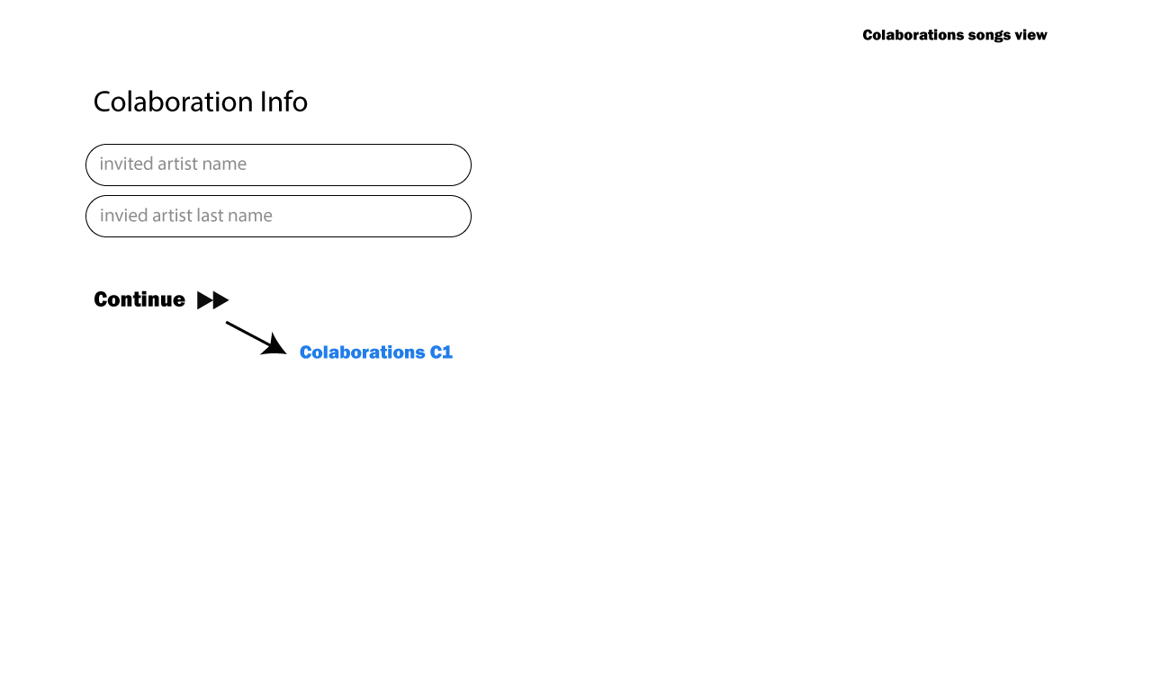

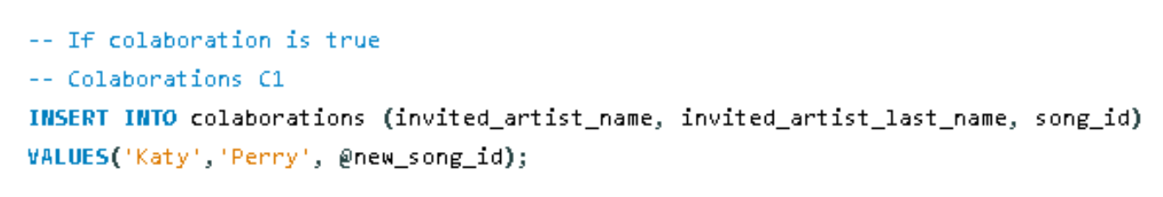
Transaction step 2
If the filed collaboration is checked, the user will enter the name and last name of the artist that participated as a collaborator in the song, and the information will be stored in the table “colaborations”
If colaboration is ture =>
Colaboration C1
Add name and lastname of the invited artist

Slide 27
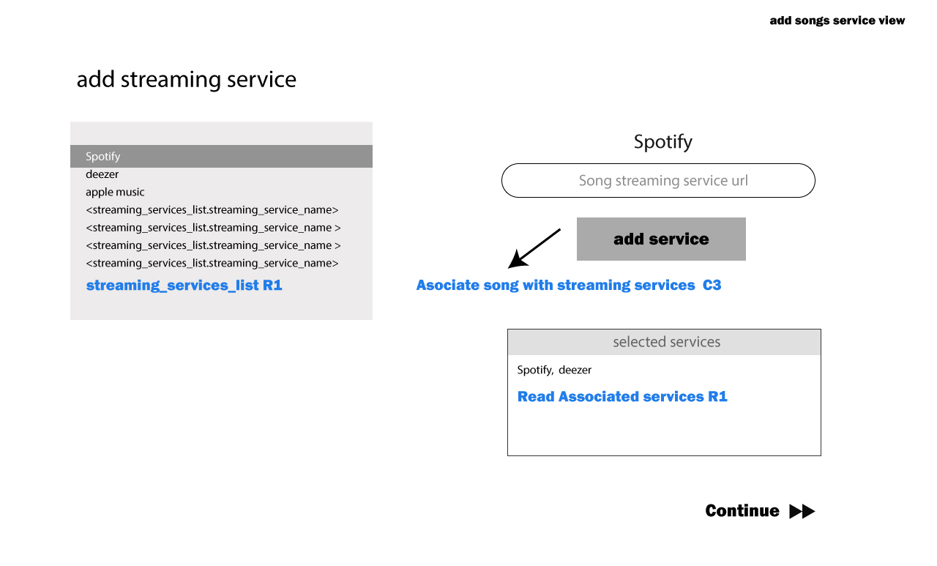
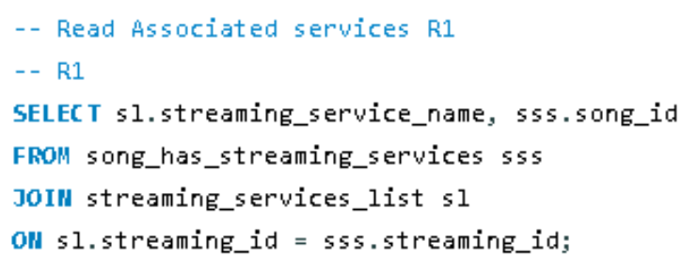
Read associated services R1
The system wil display to the user all the streaming services that has been added to the song in the table song_has_streaming_services

Slide 28
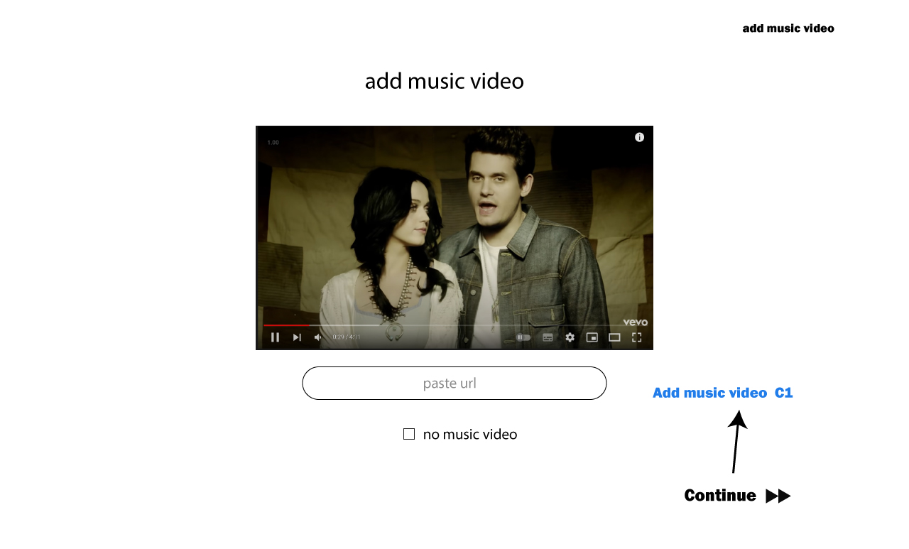
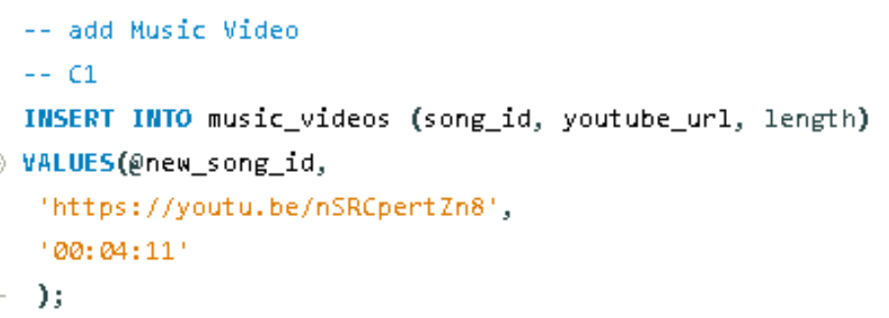
Transaction step 5
In the step 5 the user will add a music video if exist. If the song do not have a music video the system will store the value in the column “youtube_url” as null
add music video C1
The system will add the music video information and will extract the length from the video provided by the user

Slide 29
Transaction step 6
The final step of the transaction will be edit the number of songs and time length of the album as is indicated on the slide #17
If any of the steps of the transaction fails the system will make a rollback to avoid add a song with missing information.
If all the steps are completed successfully the system will commit all the changes

Slide 30
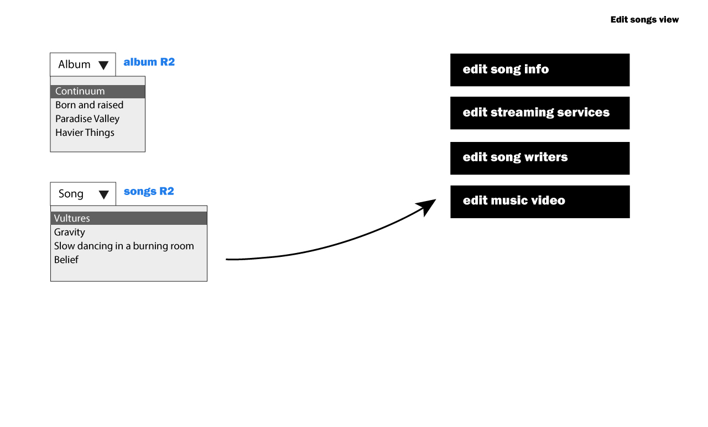
Edit Song

Slide 31
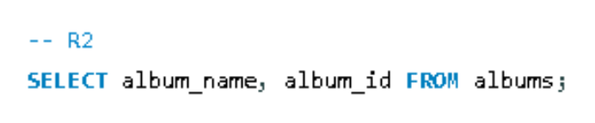
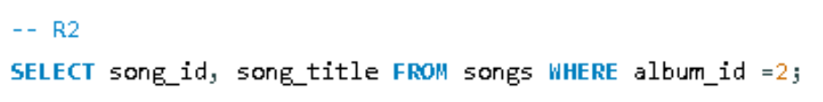
On this view the user will select from which album and what is the song that he/she want to edit
album R2
Read al the albumnes
Songs R2
Read the songs from the selected álbum

Slide 32
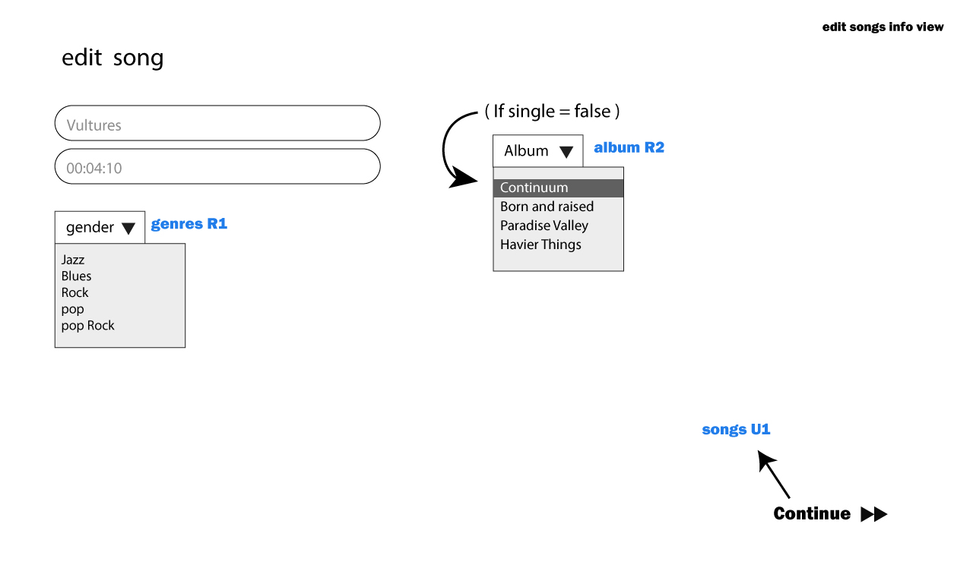
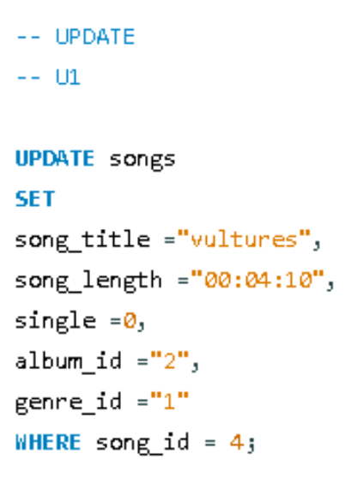
Edit song info
genres R1
album R2
song U1

Slide 33


Edit colaboration
song U2
edit colaboration infomration

Slide 34




Edit song writers
Song_writers R2
Select the current writers asociated to a song
Song_writers R1
Dispaly the lsit of writers
Songs U3

Slide 35


Edit streaming services
Read associated services R1
The system wil display to the user all the streaming services that has been added to the song in the table song_has_streaming_services
Songs U4

Slide 36


Edit music video
Songs U5

Slide 37

Delete song

Slide 38
album R2
Read al the albumnes
Songs R2
Read the songs from the selected álbum

Slide 39

Delete song Transaction (songs D1)
To delte a song, the program will run a transaction that will delete the rocords from the tables music_videos, song_has_streaming_services , colaborations, and songs_has_song_writers
If the transaction fails for any of the delete cases the system Will rollback the transaction and leave the table without changes, to avoid a remanning incomplete date.

Slide 40

Add Award View

Slide 41

Since an award may belong to a song or album the user will have to choose one of the two options. After selecting one of the options, the system Will display a dropdown menu where the user Will see the options available.
award C2
Insert a new award on the table awards

Slide 42

Edit Award View

Slide 43


award U1
Insert new values
award D1
Delete award

